Slide 1
Gosu Classes
November 13, 2015
|EOS~001|
Notes:
|EON~001|
Guidewire training materials contain Guidewire proprietary information that is subject to confidentiality and non-disclosure agreements. You agree to use the information in this manual solely for the purpose of training to implement Guidewire software solutions. You also agree not to disclose the information in this manual to third parties or copy this manual without prior written consent from Guidewire. Guidewire training may be given only by Guidewire employees or certified Guidewire partners under the appropriate agreement with Guidewire.

Slide 2
Describe the general capabilities of a Gosu class
Create packages and classes
Create static class methods
Reference class methods
|EOS~002|
Notes:
|EON~002|

Slide 3
Overview of classes
Gosu classes
Creating packages and classes
Working with methods
|EOS~003|
Notes:
|EON~003|

Slide 4
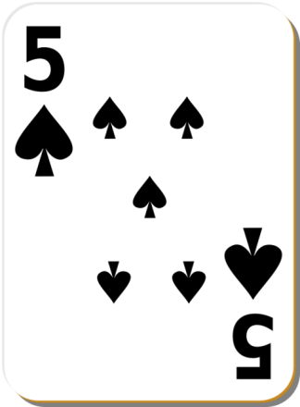
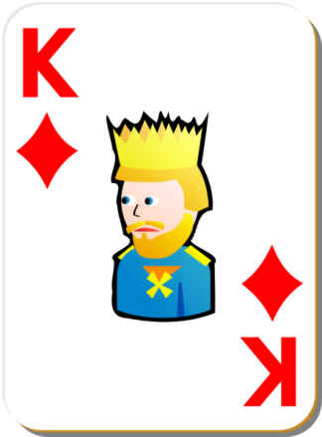
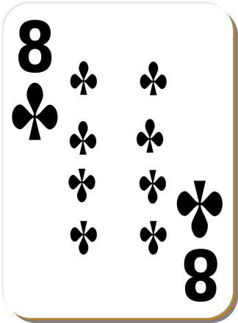
Object-oriented programming
Object-oriented programming is a programming approach that models objects and their interactions
Create a class to define a groups of objects and how they act
Create and manipulate an object, an instance of a class
Example: Card class and instances of the card class
Card Class
currentCard
nextCard
lastDiscardedCard
Card instance
Card instance
Card instance
|EOS~004|
Notes:
|EON~004|
Imagine a playing card software program and a class known as Card. In the slide example, there are three specific instances of the Card class: currentCard, nextCard, and lastDiscardedCard.
Object-oriented programming is a programming approach in which developers create classes, which are instructions for how to build a set of objects and the properties and behaviors those objects will have, and create and manipulate individual objects, known as instances of a class or type. Every class is created by a class definition, which specifies the class name, the properties that every instance of the class has, and the methods that every instance of the class has.
Object-oriented programming consists of four principles: Encapsulation, Abstraction, Polymorphism and Inheritance. Encapsulation is the hiding of a data implementation by restricting access to accessors and mutators. An accessor is a method that is used to ask an object about itself. It can be a property or a public method. Mutators are public methods that modify the state of an object, while hiding the implementation of exactly how the data gets modified. Abstraction denotes the essential characteristics of an object that distinguish it from all other kinds of object and thus provide crisply defined conceptual boundaries, relative to the perspective of the viewer. Inheritance allows you to inherit functionality from another class, called a superclass or base class. Inheritance is the ability to extend components without any knowledge of the way in which a class was implemented. Polymorphism means one name, many forms. Polymorphism manifests itself by having multiple methods all with the same name, but slightly different functionality.

Slide 5

Properties and methods
Properties
Methods
Characterize an object and its state
Define an object's actions and interactions
Card Class
currentCard
Properties
suit = "spade"
rank = 5
isFaceUp = true
Methods
turnFaceDown()
turnFaceUp()
Card instance
|EOS~005|
Notes:
|EON~005|
All instances of the same class have the same properties and methods.

Slide 6
Class definition
1 class Card { 2 var _suit : String as Suit
3 var _rank : String as Rank
4 var _isFaceUp : Boolean as IsFaceUp
5
6 function turnFaceDown() {
7 this.IsFaceUp = false
8 this.redrawCard()
9 }
10
11 function redrawCard() {
12 // redraw the card
…30 }
31 }
Line 1: keyword class followed by name declares class
Lines 2-4: Defines class properties for every instance
Lines 6-9: Defines a method every instance
|EOS~006|
Notes:
|EON~006|
In a Card class used for an actual program, the suit and rank properties would probably have constrained data types. For example, suit would be limited specifically to hearts, diamonds, clubs and spades. In the slide example, suit is a property of the type String, but could be other data types.
There is a variety of object-oriented programming languages, each with variations in syntax. In the slide example, the syntax is an example using Gosu, Guidewire's programming language.
Gosu supports object-oriented programming using classes, interfaces and polymorphism. Also, Gosu is fully compatible with Java types, so Gosu types can extend Java types, or implement Java interfaces.

Slide 7
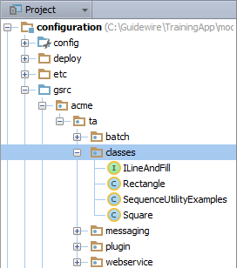
Packages
Packages organize code for convenience
Related logic
Access among classes
Hierarchy arranges packages
Only one unique fully qualified name
…\configuration\gsrc\
Create packages in gsrc
Contains any number Gosu classes, enhancements, and other types of Gosu code files
|EOS~007|
Notes:
|EON~007|
A package is an aspect of object oriented programming languages. A package is collection of grouped classes. The classes in a package have a similar function or related purpose. Often, classes in a package require access to each other while classes outside of the package do not need access.
You reference a class in a package with a fully qualified name. A fully qualified name details the package hierarchy. In the slide example, the Square class exists in the hierarchy of the acme package. For example, the fully qualified name for the Square class is acme.ta.classes.Square.
Per package hierarchy, you can only have one unique class name.

Slide 8
Overview of classes
Gosu classes
Creating packages and classes
|EOS~008|
Notes:
|EON~008|

Slide 9
Where to write configuration code
Enhancement
Always tied to an entity
Determines derived entity values
For instances of an entity
Gosu Class
Not easily associated with an entity
Organizes methods associated with performing a business task
Method associated with given class
If declared as static methods, can be used anywhere
|EOS~009|
Notes:
|EON~009|
Class methods can also be non-static. In this case, the method can only be called from an instance of the class. Often configuration developers do not write an extensive amount of non-static class methods. Integration developers, however, typically do write both static and non-static class methods.

Slide 10
Gosu Classes
A Gosu class describes a group object and its interactions
Classes organized in packages
…\configuration\gsrc\<package>
Gosu class is .gs file
Classes can define:
Constructors
Properties (with private and public access)
Methods (with private and public access)
Classes can:
Extend other classes
Implement interfaces
Override methods
|EOS~010|
Notes:
|EON~010|
Gosu classes have a package structure which contains the individual classes and the classes are extendable. Using Gosu, you can write your own custom classes and call these classes from within Gosu. You create and reference Gosu classes by name.
For example, suppose that you want to define a class called MyClass in package MyPackage with a method called getName(). You would first create the class in the …\configuration\gsrc\ folder in Guidewire Studio. Then, in Gosu Scratchpad, you can instantiate the class as an object and call the method. For example:
var myObject = new MyPackage.MyClass()
var name = myObject.getName()

Slide 11
Static methods
A static method is a method that belongs to the class in which it is declared
Only exisist on the type, not an instance of the type
Requires no object instance to call the method
Lesson focuses on static class methods
Integration developers often utilize all OOP programming techinques for all types of Gosu classes
Configuration developers often write Gosu classes and static methods
|EOS~011|
Notes:
|EON~011|
Most integration work involves full utilization of OOP capabilities, including:
Extending existing classes
Implementing interfaces
Creating instances of classes
Overriding methods
Using try/catch blocks to handle exceptions

Slide 12



Examples of static class methods
ClaimCenter
Dynamic assignment (usable when assignment is based on dynamic value such as each user's workload)
SIU lifecycle (to determine which step of process to set given object at)
PolicyCenter
Validation (used to determine if a draft policy is quotable or bindable)
Forms inference (used to determine which forms should be attached to a policy)
BillingCenter
Approval (used to determine approval of commissions, disbursements, and charge reversals)
|EOS~012|
Notes:
|EON~012|
SIU stands for Special Investigations Unit, which is the part of a claims processing organization that evaluates potentially fraudulent claims. The examples can be found in the following packages for the given product's package hierarchy:
ClaimCenter dynamic assignment: gw.api.assignment.examples package
ClaimCenter SIU lifecycle: libraries package
PolicyCenter validation: gw.validation package
PolicyCenter forms inference: gw.lob.<specific line of business>.forms packages
BillingCenter approval: gw.approval package

Slide 13
Overview of classes
Gosu classes
Creating packages and classes
|EOS~013|
Notes:
|EON~013|

Slide 14
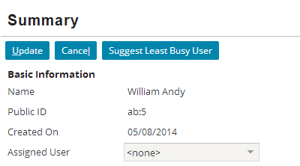

Use case: Suggest least busy user
AssignedUserUtil class contains methods for…
Finding, counting, and getting contacts for a user
Transferring contacts between users
Selecting the user with the fewest assigned contacts
PCF requires just one method that returns a value
|EOS~014|
Notes:
|EON~014|
As a sample business requirement, TrainingApp needs several methods that for working with contacts and assigned users. Because several methods are needed and these methods are called from multiple types of configuration objects, all methods will be declared in Gosu class.

Slide 15
Steps to implement a class
[Optional] Create a new package
Create a class file
Code properties and methods
Deploy the package and class
Reference the class
|EOS~015|
Notes:
|EON~015|

Slide 16
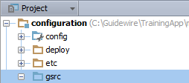
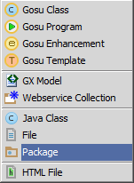
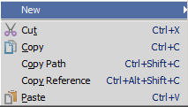
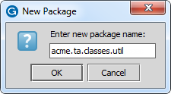
Step 1: [Optional] Create a package
In Project View, select gsrc or an existing package in …\configuration\gsrc\
Context menu → New → Package
Enter the package name
Use dot notation to create a package hierarchy
<company>.<app_code>.<mechanism>.<functional_area>
|EOS~016|
Notes:
|EON~016|
In the slide example, the package reference is for illustration purposes and does not exist in TrainingApp. In the slide example, the dot notation creates a package hierarchy of four packages: acme, ta, classes, and util. Packages are always arranged in a hierarchy. When naming a package, the package name must be unique for the given parent package or \gsrc folder. Package names should be entirely lower case. Do not create child packages in com.guidewire or gw packages.
<company> is the company's name or a suitable abbreviation.
<app-abbrv> is the Guidewire application's two-letter abbreviation, for example PolicyCenter is pc, BillingCenter is bc, ClaimCenter is cc, ContactManager is ab or cm.
<mechanism> is often batch, messaging, plugin (for predefined non-messaging, non-startable plugins), startable, webservice, or class(es)
<functional_area> is the functional area of the application.
The naming convention for packages for Gosu classes is:
<company>.<app-abbrv>.<mechanism>.<functional_area>
A package is a collection of classes grouped together because they perform related logic, and/or they should have access to each other while classes outside the package should not (though this usage of packages is less common).

Slide 17
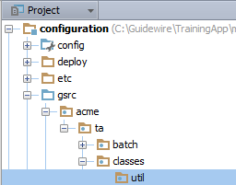
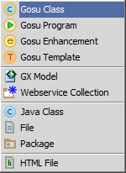
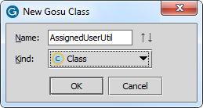
Step 2: Create a class file
In Project View, select an existing package in …\configuration\gsrc\
Context menu → New → Gosu Class
Use meaningful name with Pascal case
Capitalize the first letter in the identifier and the first letter of each subsequent concatenated word
|EOS~017|
Notes:
|EON~017|
In the slide example, the package reference is for illustration purposes and does not exist in TrainingApp. The recommended capitalization convention for Gosu class name is to use Pascal case. In Pascal case, the first letter in the identifier and the first letter of each subsequent concatenated word are capitalized.
When creating a class in Guidewire Studio, it is possible to create a hierarchy of packages for a given class using the dot notation for the class name. For example, in the New Class dialog, when you enter acme.ta.classes.util.AssignedUserUtil. Guidewire Studio will create a package hierarchy of four packages: acme, ta, classes, and util, and the AssignedUserUtil.gs class file.

Slide 18
Gosu Class file
1 package acme.ta.classes.util
2
3 class AssignedUserUtil {
4
5 }
NO construct() method
Constructor method not included in stub of class file
Method allows for a class to instantiate objects
Not required for classes with only static methods
|EOS~018|
Notes:
|EON~018|
In the slide example, the fully qualified name (package and class) is for illustration purposes and does not exist in TrainingApp. You can find the class in trainingapp.base.AssigneUserUtil.
Because configuration-level classes typically consist only of static methods, instances of the class are never created and there is no need to specify a constructor. A constructor is defined with the keyword construct. The construct method allows for a class to instantiate objects.

Slide 19
Import packages: uses keyword
1 package acme.ta.classes.util
2
3 uses gw.api.database.IQueryBeanResult
4 uses gw.api.database.Query
5 uses gw.api.database.Relop
6 uses gw.transaction.Transaction
7
8 class AssignedUserUtil {
9
10 }
Imports fully qualified name and package
Not a static import (like Java), must reference class in code
Asterisk (*) to import hierarchy
Studio will suggest class while typing class name
|EOS~019|
Notes:
|EON~019|
In the slide example, the fully qualified name (package and class) is for illustration purposes and does not exist in TrainingApp. You can find the class in trainingapp.base.AssigndeUserUtil.
You do not need to always reference a class by fully qualified name. You can import the class with the uses operator (keyword). The uses operator behaves in a similar fashion to Java language’s import command, however, explicit types always have precedence over wildcard namespace references. In Gosu, you can include all classes in a package namespace by using an asterisk (*) character to indicate the hierarchy.
While the uses operator is technically an unary operator in that it takes a single operand, the functionality it provides is only useful with a second statement. In other words, the only purpose of using a uses expression is to simplify other lines of code in which you can omit the fully-qualified type name. For this reason, you will often call it a keyword instead of operator.
You can type in the class name and method and Studio will try to resolve the fully qualified name for you if the package or namespace has not been already declared. Use ALT+ENTER over the red squiggles to see the Import Class options.

Slide 20
Step 3: Code properties and methods
1 package acme.ta.classes.util
2
3 uses gw.api.database.IQueryBeanResult
4 uses gw.api.database.Query
5 uses gw.api.database.Relop
6 uses gw.transaction.Transaction
7
8 class AssignedUserUtil {
… 55 public static function selectLeastBusyUser( ABContactNeedingReassignment: ABContact): void { …69 var leastBusyUser = contactManagerResultSet.FirstResult
…86 ABContactNeedingReassignment.AssignedUser = leastBusyUser
89 }
…
130 }
Pascal case for property names
Camel case for method names
|EOS~020|
Notes:
|EON~020|
In the slide example, the fully qualified name (package and class) is for illustration purposes and does not exist in TrainingApp. You can find the class in trainingapp.base.AssignedUserUtil.
Line 1: declares the package in which the class exists.
Lines 3-6: imports other classes by fully qualified name for this class to reference using only the class name.
Line 8: declares the class name.
Lines 55-89: define a static method. The method does not return a value.
The recommended capitalization convention for properties is to use Pascal case. In Pascal case, the first letter in the identifier and the first letter of each subsequent concatenated word are capitalized. A property is used to get and set an object value. You can precede the property keyword with one or more modifier keywords. Guidewire modifiers include public and private, which are access modifiers. A property is public by default, meaning that it can be referenced from anywhere in a Guidewire application that uses Gosu.
The recommended capitalization convention for methods is to use Camel Case. In Camel Case, the first letter of an identifier is lowercase and the first letter of each subsequent concatenated word is capitalized. A method can return any type of value available in Gosu, including Boolean, String, and Integer. Like the property keyword, you can precede the function keyword with one or more modifier keywords. Guidewire modifiers include public and private, which are access modifiers. A method is public by default, meaning that it can be referenced from anywhere in a Guidewire application that uses Gosu. A static member means that the member exists only on the single type itself, not on instances of the type. Access static members on Java types just as you would native Gosu types. For Gosu code that accesses static members, you must qualify the class that declares the static member.

Slide 21
Step 4: Deploy package and class *New*
Restart Server
New package and class loaded at server startup
Package
Gosu Class (.gs)
|EOS~021|
Notes:
|EON~021|

Slide 22
Step 4: Deploy Gosu classes
Reload changed classes
Compile classes
Main Menu → Run → Reload Changed Classes
Main Menu → Build → Compile
CTRL+SHIFT+F9
Gosu Class (.gs)
Gosu Class (.gs)
|EOS~022|
Notes:
|EON~022|
You can deploy new and modified Gosu classes when the server is running in run or debug server process. If the class exists in a new package, then you must restart the server.
If your modified enhancement (.gs) contains a new displaykey, then you will also need to reload PCF files using ALT+SHIFT+L, the Guidewire API and/or internal server tools.

Slide 23

Step 5: Reference class static method (1)
Toolbar button widget's action property calls class static method
Assigned User field is set to a user returned by the selectLeastBusyUser() static method
|EOS~023|
Notes:
|EON~023|
The selectLeastBusyUser() method select the least busy user for a given anABContact. In the slide example, the toolbar button widget 's action property references the static method.
You can find the example in TrainingApp in ABContactSummaryPage.pcf.

Slide 24
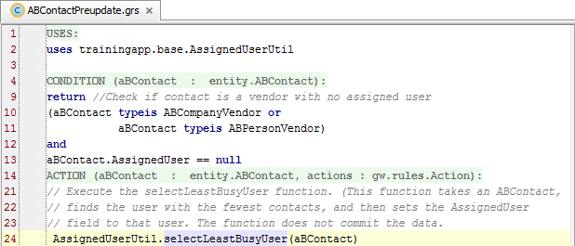
Step 5: Reference class static method (2)
Rule action calls the selectLeastBusyUser() static method
Line 2: Imports AssignedUserUtil class
Line 24: Calls static method, selectLeastBusyUser()
|EOS~024|
Notes:
|EON~024|
The selectLeastBusyUser() method select the least busy user for a given aBContact. In the slide example, the rule action calls the static method.
You can find the example in TrainingApp in the "ABPU3000 - Subtype AB—Vendor" rule. The rule is in the ABContact Preupdate rule set in the Preupdate rule set category.

Slide 25
Describe the general capabilities of a Gosu class
Create packages and classes
Create static class methods
Reference class methods
|EOS~025|
Notes:
|EON~025|

Slide 26
What is a package?
How do you call a static method from a class?
Why put logic in a Gosu class method as opposed to an entity enhancement?
What two keywords appear in the declaration of a Gosu class method used for configuration work? What does each keyword mean?
|EOS~026|
Notes:
|EON~026|
Answers
1) A package is a group of classes gathered together either because they execute a common business task, or because access to the classes must be limited only to the classes in the package, or both.
2) You call a static method from referencing the method name from the class. You must either reference the fully qualified name of the class or import the class using the uses keyword followed by the reference to the package path.
3) The logic in the class can managed in one place. Gosu enhancements can reference the Gosu class.
4) The public keyword identifies that the method is available to any code that invokes it outside of the class itself. The static keyword identifies that the method belongs to the class itself and can be declared even if there is no instance of the class.

Slide 27
|EOS~027|
Notes:
|EON~027|

